Slide 1
B Tech Integrated In Plant Training Presentation A.Y. Semester:
Presented by : Anirbaan Ghatak, C206.
Organization Name : E-RevBay Pvt. Ltd.
Industry Mentor : Mohit Vora
Faculty Mentor : Supriya Agrawal
Under the guidance of :

Slide 2
Roadmap
About the Organization ( No. of slides -1)
About the Department (1)
About the Project/s (2)
Description of technical tasks (6-8)
Brief of new skills gained (1)
Overall learnings (1)
Comments and Future Plan(1)
6th May 2023

Slide 3
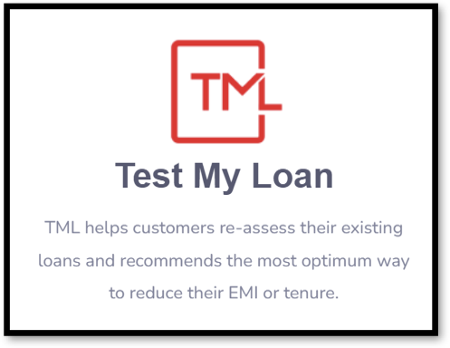
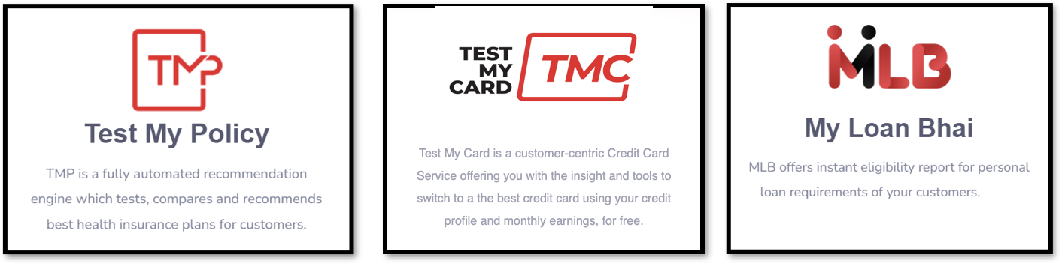
E-RevBay Pvt. Ltd.
Notes:
About the company from the final Report

Slide 4
The Tech Department
Notes:
From the final report get a pic here from Dall-e

Slide 5
Projects (Completed)
Credit Analysis Report
PNB bank Insurance RPA
Data Verification

Slide 6
Projects (Ongoing)
TMCC
Car Pe Loan
MLB-TML
Equifax Excel Dashboard

Slide 7
Description of Technical Tasks
Some one-liner on description

Slide 8
Credit Analysis Report
What Is credit Analysis report
Write About The first pdf to XML but then realizing it just dumb
Then going with the whatever nilay did check github
Helped in CSS of the Main report
Then Made the Login Pages routed them along with cookies/sessions and then Firebase Authentication for security reasons
Then Deployment Part, assiseted in deployment of Website first on Cpanel then Azure Web Apps
Put that flow chart in there somewhere

Slide 9
Timing Image
Chindi CAR report Image

Slide 10
The CAR Website

Slide 11
RPA
RPA
How not to use fancy methods and stick to basics
How to Do logic Fixing
Make flowcharts
How API’s work
Tools which is rpa

Slide 12
Some flowchart or the RPA ka video
Ask Harsh

Slide 13
Data Verification
Power Automate Design and Logic
Azure VM’s power-desktop or something and then virtual desktop
Power Automate on Virtual machine
Changed from power Automate to python Code
Then tried run it on virtual machine

Slide 14
Virtual Machine Images

Slide 15
TMCC
Selenium first introduction what is it
Scraping Initials
Excel
Tried using knn neighbouris for recommendation engine
Data Cleaning

Slide 16
Car Pe Loan
Selenium Scraping
How Selenium scraping works
Integrating Selenium scraping and API
Phase 1 Code to find car using Eparivhan and then find the car across the web
API integration in detail or how api’s work

Slide 17
MLB-TML
SQL fetching s

Slide 18
Questions??

